Slide 1
Continuous Delivery
Presented by Tanya Singhal

Slide 2
Agenda
  The Problem of Delivering Software
  A Deployment Pipeline
  Problems in deploying software manually
  How to Achieve Goal of continuous delivery
  Principles of Software Delivery
  Continuous integration
  Why Testing Strategy is necessary?
  What is Deployment Pipeline
  Preparing To Release
Practices of build and Deployment Scripting
Project Structure for Applications That Target the JVM
Deployment Scripting

Slide 3
Why Continous Delivery?
If we want
Short cycles for software Production.
Release at any time.
Automate the process of software delivery.

Slide 4
What is Continous Delivery(CD)?
CD is the automation if the entire Delivery System i.e. Build, Deployment, Test and Release to continuously deliver new versions of software to production
CD is enabled through the Deployment Pipeline

Slide 5
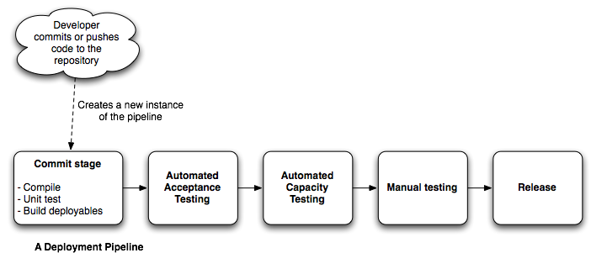
A Deployment Pipeline
It’s a process of getting software from version control into the hands of users in a single click of button.

Slide 6
Problems of delivering software:Antipatterns
Antipattern 1: Deploying Software Manually.
Dependency between Developer Tester and Operation team.
Detailed Document too many steps and the steps may go wrong.
Frequent call to developer by release team.

Slide 7
Antipattern Continue….
Antipattern 2: Deploying to the production like Environment after Development is complete.
Tester are Doing their work on developer Machine.
Operation team will see the software at the time of release.
All the documentation like Configuration files, Database Migration and Deployment document are untested in staging or production.

Slide 8
Antipattern Continue….
Antipattern 3: Manual Configuration Management of production Environment
Change in OS configuration.
Change in DB connection setting on Application Server.
Increase number of thread in thread pools on Application Server.

Slide 9
Antipattern Solutions
Automate and Integrate the Build, Deployment, Test, Release activity in Development.
Automate the Build as much as possible.
Start deploying to a prod-like environment as soon as you start developing.
Set up your entire environment using an automated process that is stored in version control.

Slide 10
How to Achieve Goal of continuous delivery
Automated
Frequent Releases
Feedback

Slide 11
Principles of Software Delivery
Create a Repeatable, Reliable Process for Releasing Software
Automate Almost Everything
Keep Everything in Version Control
If It Hurts, Do It More Frequently, and Bring the Pain Forward
Build Quality In
Continuous Improvement

Slide 12
Configuration Managment
Term is often known as version control.
Helps in storing retrieving and uniquely identified artifacts
Helps to reproduce a particular state of the software’s binaries and configuration
Store binary images of their application servers, compilers, virtual machines

Slide 13
Continue…
Can I easily make an incremental change in
      Any of the features of product
      And deploy it in all my environment
Can I easily see each change and trace it back
      what the change was
      who made it
      When they made it

Slide 14
Last but not the least,
Information should be easily available to each member
  Frequent check in
  Automatically benefits
    Efficient delivery
    Reduced feedback

Slide 15
Points we just discussed can be achieved by following practice
Using Version Control
Check In Regularly to Trunk
Use Meaningful Commit Messages
Managing Dependencies
    External libraries
    Components
    Software configuration

Slide 16
Why Version Control is Important
Helps to reproduce a particular state of the software’s binaries and configuration
What was done when, by whom
allows you to recover an exact snapshot of the state of the entire system, from dev environment to prod environment, at any point in the project’s history
store binary images of their application servers, compilers, virtual machines

Slide 17
Continuous integration
An extremely strange and serious problem with many software projects is that-
For “long periods of time during the development” process
the application is not in a working state
Problems faced-
  Significant time software is unusable
  Nobody is interested in trying to run the whole application until it is finished
  Software is not compatible at the time of delivery
  Hell lot of problems during build

Slide 18
Prerequisites of continuous integration
Version Control
An Automated Build
Agreement of team
Create a Comprehensive Automated Test Suite
Keep the Build and Test Process Short
Managing Your Development Workspace

Slide 19
Essential Practices In Continuous Integration
Don’t Check In on a Broken Build
Always Be Prepared to Revert to the Previous Revision
Don’t Comment Out Failing Tests
Test-Driven Development
Failing the Build for Slow Tests
Always Run All Commit Tests Locally before Committing, or Get Your CI Server to Do It for You

Slide 20
Why Testing Strategy is necessary?
functional aspects of the system
Increase confidence
reduced support costs
Capacity, security,
and other nonfunctional requirements are established early on, and automated
test suites are written to enforce them.

Slide 21
Types Of Test
Business-Facing Tests That Support the Dev Process
Technology-Facing Tests That Support the Dev Process
Business-Facing Tests That Critique the Project
Technology-Facing Tests That Critique the Project

Slide 22
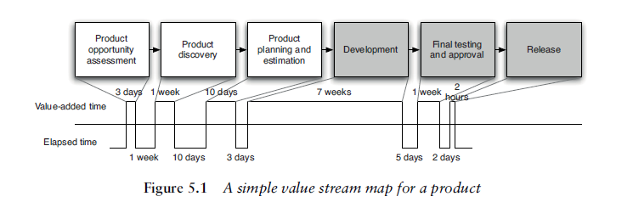
What is Deployment Pipeline
A deployment pipeline is an automated manifestation of your process for getting software from version control into the hands of your users.

Slide 23
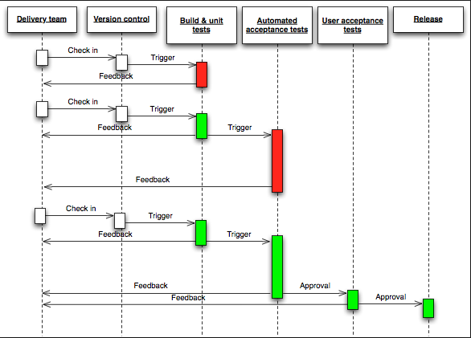
Deployment Pipeline

Slide 24
Deployment Pipeline Practices
Only Build Your Binaries Once
Deploy the Same Way to Every Environment
Smoke-Test Your Deployments
Deploy into a Copy of Production
Each Change Should Propagate through the Pipeline Instantly
If Any Part of the Pipeline Fails, Stop the Line

Slide 25
Preparing To Release
Have a release plan
Minimize the effect of people making mistakes by automating as much of the process as possible
Rehearse the procedure often in prod-like environments
Have the ability to back out a release if things don’t go according to plan
Have a strategy for migrating configuration and prod data as part of the upgrade and rollback processes

Slide 26
Practices of build and Deployment Scripting
Create a Script for Each Stage in Your Deployment Pipeline
Use the Same Scripts to Deploy to Every Environment
Use Your Operating System’s Packaging Tools
Evolve Your Deployment System Incrementally

Slide 27
Project Structure for Applications That Target the JVM
Project Layout
Managing Source Code
Managing Tests
Managing Build Output
Managing Libraries

Slide 28
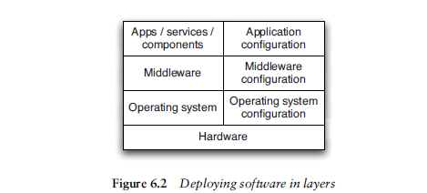
Deployment Scripting
Deploying and Testing Layers

Slide 29
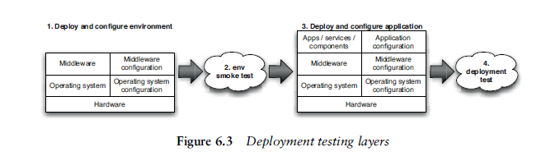
Deployment Testing Layers
Testing Your Environment’s Configuration

Slide 30

Any Questions?

Slide 31
Thank You!

